Slide 1
RESCUE READY: Smart Web-Based Emergency Alert and Response System
Batch -31
Team Members:
PAVITHRA S (2023PECCS312)
POOJA A (2023PECCS312)
Department: Computer Science And Engineering
Coordinator Name: Mr.C.Elangovan, Mrs.Vinmathi
Date: 27-10-2025

Slide 2
Problem statement
Emergencies require immediate and accurate responses, yet existing solutions often lack real-time support and comprehensive guidance.
Current apps fall short in integrating advanced technologies like AI
assessments and AR-guided first aid. There is a need for a unified
emergency response app that enhances user safety with real-time
alerts, health monitoring, and clear, actionable guidance. ✓
Mapped SDG Goal(s) SDG 3 – good health and well-being Target 6.1: By 2025, Our app aims to bridge this gap, providing swift, accurate, and accessible emergency support.

Slide 3
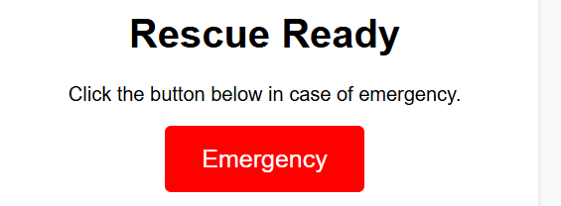
PROPOSED SOLUTION
Our proposed solution is a comprehensive emergency response app that integrates advanced technologies to enhance user safety and support. The app will feature real-time SOS alerts, AI-driven health assessments, AR-guided first aid, and continuous health monitoring through connected devices.
It aims to provide immediate, accurate assistance by connecting users with emergency contacts and responders quickly and efficiently. This unified approach ensures that users have all the necessary tools to handle emergencies effectively, reducing response times and improving outcomes.

Slide 4
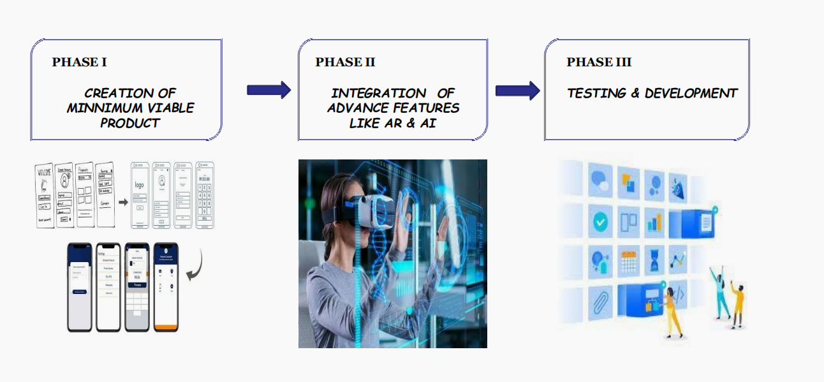
IMPLEMENTATION PLAN
1. Requirement Gathering
2. Tech Stack Selection
3. Module-wise Implementation
4.Testing
5. Final Integration
6. Future Enhancements (Post-Selection / App Phase)

Slide 5
CASE STUDY/BASE PAPER
Abstract— Mobile applications are becoming integral for women and children by complementing their level of safety and security. This paper proposes a novel system called "Rescue Ready," a mobile real-time personal safety application for such users. The system includes several features, such as a “Danger Button” which sends an SMS alert with the user’s live location, alarms the police, and starts buzzing. Rescue-ready urgent alerts the authorities and identifies the users through clear and fast communication protocols. It has been designed with a user-friendly interface, aiming at less than one second response time to allow the app to work in real-time. In this paper, we analyse system architecture along with the key features and discuss the results from its extensive testing and use of modern techniques for automated Assistance.
Index Terms— Personal safety, real-time alert, location
sharing, emergency app, mobile security, Rescue Ready

Slide 6
TARGETED USER
General Public
Elderly People or Individuals with Medical Conditions
College Students & Hostellers
Women and Vulnerable Groups
Disaster-Prone or Remote Areas

Slide 7
FUTURE SCOPE
Mobile app version for wider reach
Real-time map of helpers/responders
Voice-activated emergency triggers
Integration with wearables
Response time tracking and analytics

Slide 8
MODULES
Module 1: User Registration and Authentication Description: Handles user onboarding, login, and profile management. Features: Signup/Login using email & password Role selection (e.g., Emergency Reporter, Responder) Authentication with Firebase Auth or custom JWT Input: Name, email, password, role Output: Login confirmation, profile created
Module 2: Location Tracking and Management Description: Captures and updates real-time user locations to Firestore. Features: Browser geolocation API integration Location stored in Firestore Auto-update every X seconds/minutes Input: Device location (lat, lng) Output: Stored user location in database

Slide 9
🔹 Module 3: Emergency Trigger System (Emergency Button) Description: Allows users to raise an emergency alert. Features: Emergency button on homepage On click → captures user’s location Triggers alert system with coordinates Input: Button click + current location Output: Alert broadcast initiation 🔹 Module 4: Nearby Users Detection Module Description: Detects nearby registered users within a given radius. Features: Haversine formula for geo-distance Radius expansion logic if no helpers found Dynamic response filtering Input: Emergency location, all user locations Output: List of nearby users (email, distance)

Slide 10
🔹 Module 5: Email Alert Notification System Description: Sends email alerts to nearby users. Features: Integration with Nodemailer or SendGrid Sends emergency location + response link Allows “Accept” or “Ignore” response Input: Nearby user emails, location Output: Email alert sent with location and call to action 🔹 Module 6: Helper Response Handling Description: Allows nearby users to respond to emergency alerts. Features: Clickable “I Can Help” link in email Updates Firestore with responder status Sends confirmation to requester Input: Response click from email Output: Updated Firestore status, confirmation sent

Slide 11
Module 7: Emergency History Module Description: Displays past emergency requests and their outcomes. Features: Fetches data from Firestore Shows timestamps, location, responder status Admin panel view for analysis Input: Request from frontend dashboard Output: Table/list of emergency logs 🔹 Module 8: Admin Monitoring Dashboard (Optional/Advanced) Description: Visual admin panel to monitor system usage and emergencies. Features: Emergency map with pins User statistics Responder logs Input: Firestore data Output: UI-based dashboard (charts, tables, maps)

Slide 12
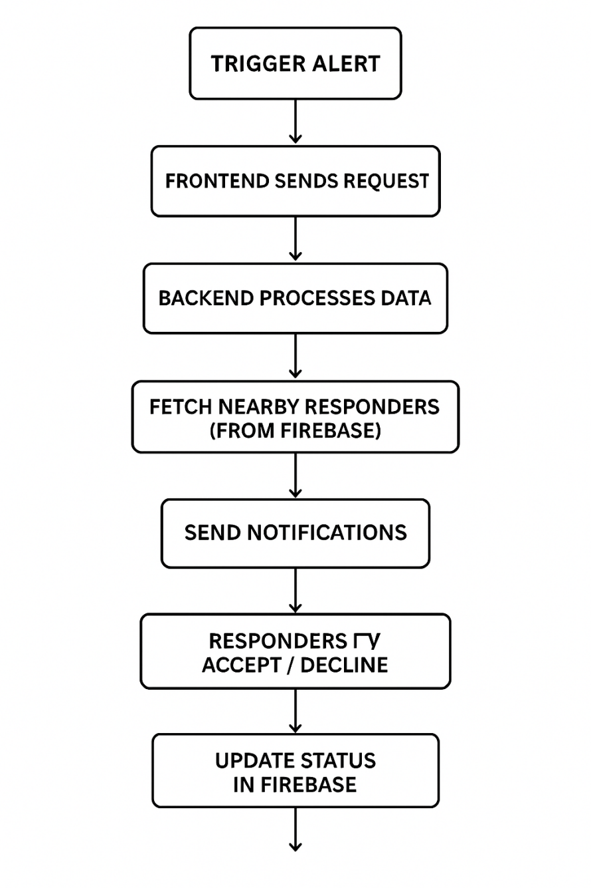
ARCHITECTURE

Slide 13
LITERATURE SURVEY
Location- and Crowd-Sourced Alert Methods: A large body of work shows that mobile crowdsensing and volunteer first-responder (VFR) models can shorten time-to-help by leveraging nearby users’ smartphones for incident awareness and rapid dispatch. A systematic review of disaster-management crowdsensing outlines how phone sensors, user reports, and lightweight cloud backends create scalable, community-driven safety networks with real-time updates and geo-tagged events [1]. At the systems level, information crowdsourcing frameworks formalize workflows where first responders, citizens, and devices collaboratively explore and report evolving emergencies, emphasizing data quality and timely diffusion to affected users [2]. Clinically focused evaluations of smartphone-based VFR dispatch demonstrate that automated ETA-aware algorithms (using incident and responder locations plus transport modes) can improve assignment quality and arrival likelihood in medical emergencies [3], while field deployments show that community first-responder apps run 24/7 alongside EMS and can shorten time-to-CPR in out-of-hospital cardiac arrest scenarios [4]. Together, these studies motivate Rescue Ready’s radius-based nearby-helper alerts, volunteer acceptance flows, and escalation (expanding the radius when no helper accepts promptly).
Geo-targeting & Geofencing for Notifications: For precise outreach, geo-fenced alerting remains central. Recent work on cell broadcast (CBS) proposes a Minimum-Area-Quadrilateral (MAQ) geofencing algorithm that simplifies irregular polygons to reduce broadcast payload and improve location-based delivery efficiency—useful when covering complex neighborhood shapes during incidents [5]. Beyond public warnings,

Slide 14
Geofencing is also applied to traffic safety, where constrained zones improve interactions between drivers and emergency vehicles and reduce collision risk—evidence that careful geo-target design can change behavior under stress [6]. Complementary studies on mobile guidance during wildfires show how app-based, real-time, geo-targeted information helps people choose safer routes and actions during dynamic hazards, underscoring the value of granular, location-aware messaging in life-critical contexts [7]. These insights inform Rescue Ready’s configurable radii, dynamic geofences, and context-aware broadcast scopes. IoT/Cloud Backends & Real-time Architectures: Modern emergency systems pair IoT sensing with cloud services for sub-second ingestion and notification. An IoT-based Smart Emergency Response System (SERS) integrates multi-domain sensors (vehicle, home, health) with cloud pipelines and reports ~3 ms server response and >99% accuracy, highlighting that cloud-native paths can meet stringent latency targets for alerts [8]. On the app side, socket-based and PWA architectures (e.g., Socket.IO/WebRTC or React PWAs) demonstrate one-tap SOS flows with live map updates, stable connectivity, and offline-tolerant frontends—patterns directly reusable in Rescue Ready’s browser-based UX [9]–[11]. Engineering case studies of alerts + live tracking + monitoring reaffirm the practicality of combining push/email/SMS, real-time location writes, and dashboard analytics in one mobile stack [12]. These findings support Rescue Ready’s use of web-friendly stacks (HTTP + WebSocket), real-time DBs, and map-centric UIs. Positioning Accuracy & Dispatch Logistics: Accurate, quick location fixes are critical. A recent study on 5G-assisted GPS for emergency calls compares Mobile-Station-Based vs. Assisted modes and finds lower response time for MS-based positioning, while 5G reduces assistance data acquisition time to ~1.4 s, improving fix latency without degrading accuracy [13]. In parallel, ambulance dispatch research emphasizes GPS/GSM

Slide 15
telemetry and route optimization to reduce scene arrival time and coordinate stakeholders (hospital, ambulance, family) [14]. These insights justify Rescue Ready’s emphasis on fast fix acquisition (fallbacks, retries), ETA-aware helper selection, and handoff to EMS when appropriate. Design & Usability Considerations: Prototype and case-study apps consistently converge on single-tap SOS interactions, minimal cognitive load, and clear status feedback to users and responders [9], [11], [12]. Studies also highlight reliability under poor connectivity and transparent privacy handling as adoption drivers, both relevant to Rescue Ready’s token-secured APIs, opt-in location sharing, and role-based access.

Slide 16
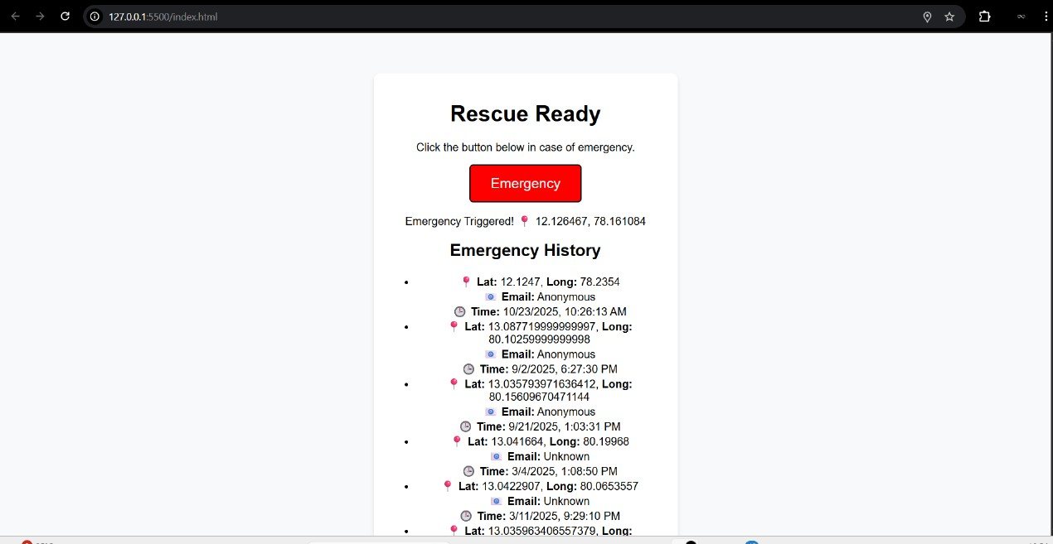
OUTPUT

Slide 17
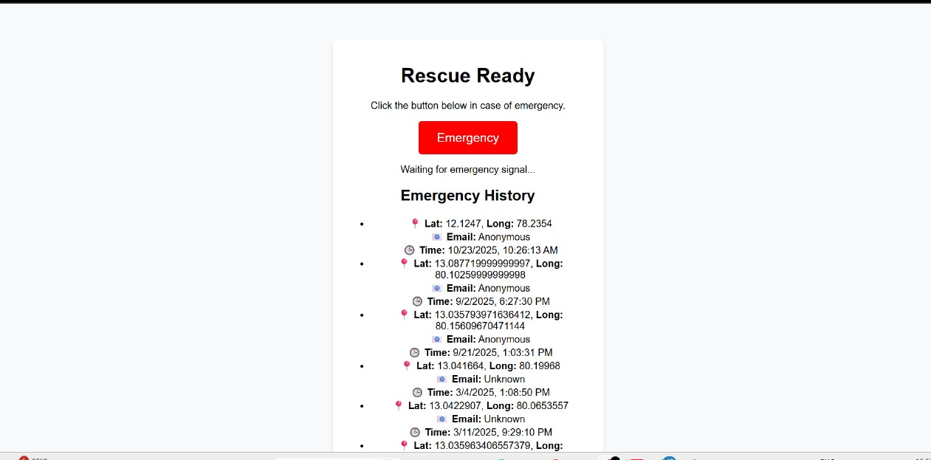

Slide 18
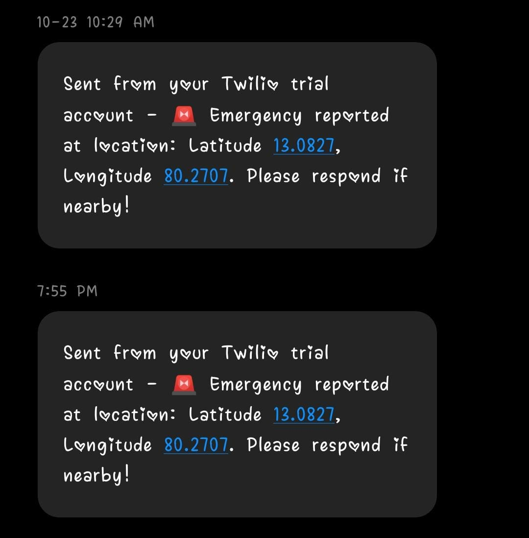
USER NOTIFICATION

Slide 19
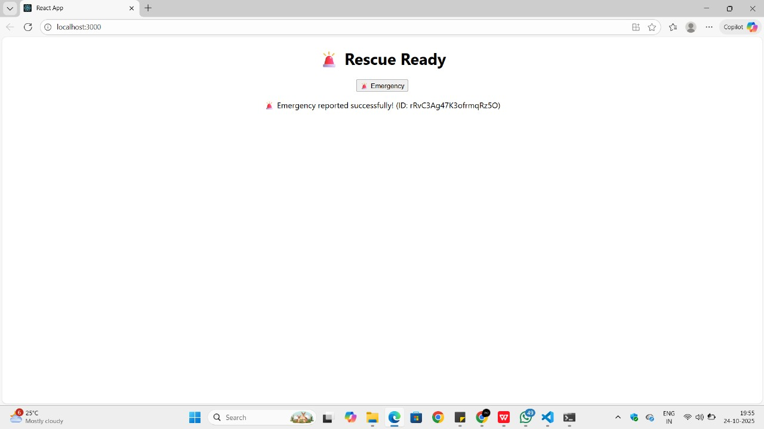

Slide 20
REFERENCES
[1] A. Faiz, S. Kumar, and P. Sharma, “Smart Vehicle Accident Detection and Alarming System Using a Smartphone,” IEEE Transactions on Intelligent Transportation Systems, vol. 16, no. 3, pp. 1212–1220, 2015.
[2] N. Kattukkaran, V. Rajan, and A. Shaji, “Intelligent Accident Detection and Alert System for Emergency Medical Assistance,” IEEE International Conference on Communication and Signal Processing (ICCSP), pp. 1238–1242, 2017.
[3] C. K. Gomathy and N. S. Reddy, “Accident Detection and Smart Rescue System,” IEEE 7th International Conference on Advanced Computing (ICoAC), pp. 76–82, 2021.
[4] G. S. Rathod, M. K. Tiwari, and S. Mishra, “Intelligent Accident Detection and Alerting System Based on Machine Learning over IoT,” IEEE Access, vol. 10, pp. 21212–21224, 2022.
[5] P. Josephinshermila and R. Ravi, “Accident Detection Using Automotive Smart Black Box Based Monitoring System,” Elsevier Procedia Computer Science, vol. 197, pp. 254–262, 2023.
[6] S. Sharma and P. Gupta, “IoT-Based Smart Health Monitoring and Emergency Alert System,” IEEE Internet of Things Journal, vol. 7, no. 8, pp. 7440–7448, 2020.
[7] M. S. Islam, T. Rahman, and K. Hasan, “Real-Time Accident Detection and Notification System Using IoT,” IEEE Region 10 Conference (TENCON), pp. 1803–1808, 2019.
[8] R. Dubey, P. Singh, and A. Jain, “Cloud-Based Emergency Management System Using GPS and IoT,” IEEE International Conference on Cloud Computing in Emerging Markets (CCEM), pp. 52–58, 2020.

Slide 21
[9] A. Patel, R. Desai, and V. Gupta, “Emergency Response Optimization Using Cloud and Mobile Technologies,” IEEE Smart Cities Conference (ISC2), pp. 230–236, 2021.
[10] S. Thomas, A. Mathew, and J. Joseph, “Smart Rescue: Real-Time Accident Detection and Response Using IoT,” IEEE 4th International Conference on Computing Methodologies and Communication (ICCMC), pp. 890–897, 2020.
[11] A. Singh and D. Kumar, “Location-Based Alert and Tracking System Using Firebase and Android,” IEEE International Conference on Information Technology (InCITe), pp. 413–418, 2018.
[12] M. Gupta and T. Banerjee, “Emergency Medical Response Using IoT-Based Cloud Services,” IEEE Global Humanitarian Technology Conference (GHTC), pp. 12–18, 2021.
[13] N. A. Khan and P. Raj, “IoT-Based Real-Time Emergency Notification System,” IEEE 8th International Conference on Smart Computing and Communications (ICSCC), pp. 311–317, 2022.
[14] R. Jain, S. Agarwal, and P. Sinha, “Smart City Emergency Response System Using Cloud IoT Integration,” IEEE International Conference on Emerging Trends in Engineering, Technology and Science (ICETETS), pp. 405–410, 2019.
[15] D. Prakash, M. Balaji, and V. Srinivasan, “An IoT Based Accident Detection and Rescue Information System,” IEEE 2nd International Conference on Smart Electronics and Communication (ICOSEC), pp. 1500–1506, 2020.
[16] T. R. Akshaya and R. Kannan, “IoT Enabled Smart Emergency Assistance System,” IEEE International Conference on IoT and Application (ICIOT), pp. 40–46, 2018.
[17] A. Mehta and S. Joshi, “Cloud-Based Real-Time Alert Management for Disaster Response,” IEEE Transactions on Cloud Computing, vol. 8, no. 5, pp. 620–630, 2020.
[18] M. R. Arif and J. Singh, “A Community-Centered Emergency Response Platform Using Cloud and IoT,” IEEE Smart Technologies for Emergency Response Conference, pp. 102–108, 2022

Slide 22
[19] V. B. Singh and P. Devi, “Real-Time Data Monitoring and Rescue System Using Firebase,” IEEE International Conference on Recent Trends in Electronics, Information & Communication Technology (RTEICT), pp. 230–236, 2021.
[20] A. George and K. Nair, “Real-Time Emergency Alerting and Tracking Using Web Technologies,” IEEE International Conference on Computational Intelligence and Computing Research (ICCIC), pp. 412–418, 2023.

Slide 23
THANK YOU

